Slide 1
REPORT ON PROGRESS OF EXECUTION FOR GRADUATION THESIS

Slide 2
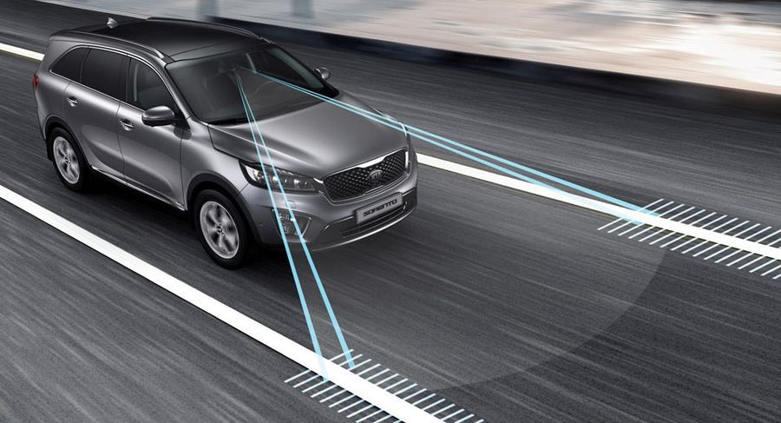
CONSTRUCT OF LANE DEPARTURE WARNING SYSTEM USING RASPBERRY PI
ADVISOR: NGUYEN DANG QUANG, M.S
STUDENT’S NAME:
NGUYEN TUAN KIET 14110348
NGUYEN QUOC TINH 14110422

Slide 3
CONTENT
The scope of the study
Target
Main content
Work done
Disadvantage

Slide 4
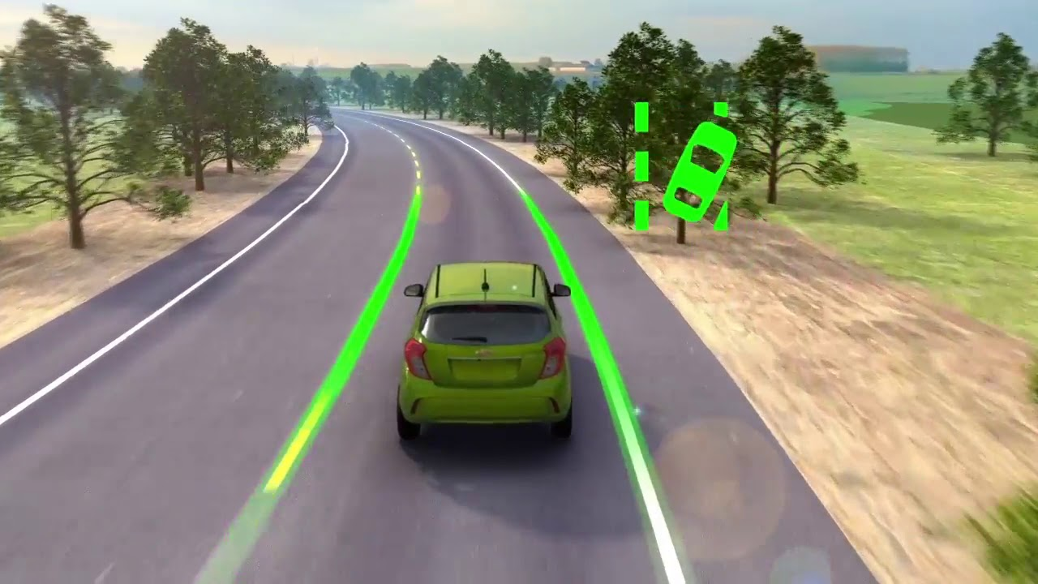
THE SCOPE OF THE STUDY
a. Target:
At the end of this thesis, we aim to have a device which uses Raspberry Pi 3 and Raspberry Pi Camera Module capable of:
Detecting lane markings on the road surface with various weather conditions and different road types.
Warning the driver of unintended lane departures.

Slide 5
THE SCOPE OF THE STUDY
b. Main content:
Fundamental
Introduce about Raspberry Pi 3, Raspberry Pi Camera Module and accessories.
How to work with the devices.
Introduction to OpenCV library.
Canny edge detection algorithm, Hough transform method.

Slide 6
THE SCOPE OF THE STUDY
b. Main content:
Construct of lane departure warning system using Raspberry Pi
Using OpenCV library, Canny edge detection algorithm, Hough transform method to detect lane.
Using blink lights to warning the driver.

Slide 7
WORK DONE
Prepare the necessary equipment.
Install Raspbian OS and OpenCV library on Raspberry Pi 3.
Research of Canny Edge detection algorithm and Hough transform method. Build a lane departure warning system, detecting the lane of success from the knowledge learned.

Slide 8
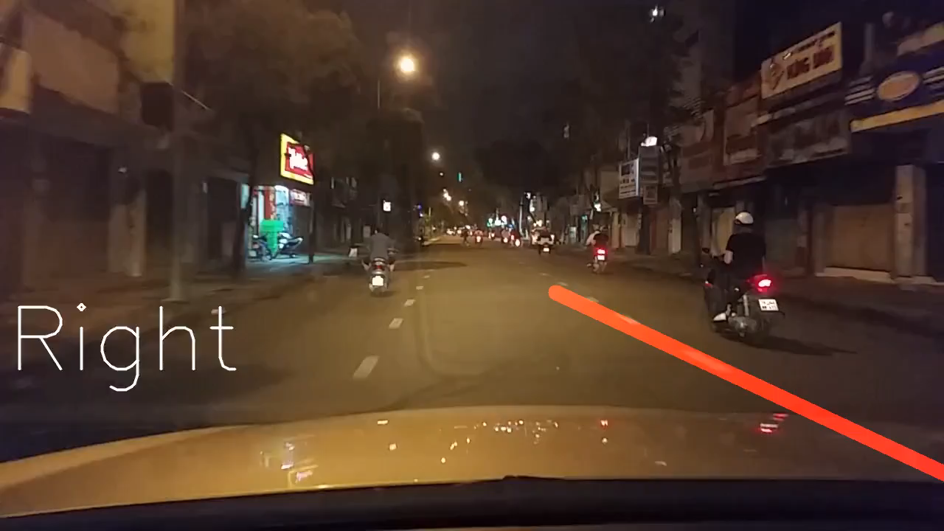
WORK DONE

Slide 9
DISADVANTAGE
Raspberry Pi 3 is the latest version but weak configuration, processing speed is very slow.

Slide 10
THE END
THANKS FOR TEACHERS WERE BEEN LISTEN!

